Slide 1
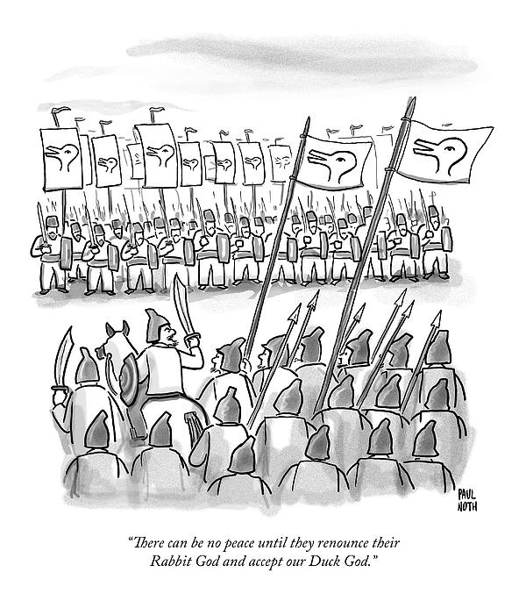
MAiD MD-SUMC
Madeline Li MD PhD
Psychiatrist, Princess Margaret Cancer Centre
AGHPS 13th Leadership Summit
October 27, 2023

Slide 2
DISCLOSURES
Former Head, University Health Network MAiD Program
Expert Witness, Lamb v Attorney General litigation
Former Chair, Capacity and Vulnerability Working Group, Canadian MAiD Curriculum Development Project (CMCDP)
Scientific Lead, CMCDP
The opinions expressed in this presentation are mine. They do not represent the opinions of any of the organizations with which I’m affiliated; and, I think that’s a damn shame!
Notes:
I have tons of personal conflicts about MAID. I would not say I am neutral on the topic of MAiD MD-SUMC, but my intent today is….I’m not going to detail or debate the controversy…and here’s why

Slide 3
Global Rates of Assisted Dying
(6.6%)
(5.5%)
2022
Quebec
Vancouver
Island
4th Annual Report on MAiD in Canada
13, 241 MAiD deaths in 2022; 31.2% increase; 1 in 25 deaths
Notes:
So what has happened with rates of assisted deaths as a % of total deaths
Countries with more permissive laws, there has been steady growth, while those which limit prognosis to 6 months generally plateaud
In 2021, 3.3%, in some parts of Canada (Quebec 5.1%), already exceeds the Netherlands (4.8%), but we’ll see as Netherlands permits for children and now any age

Slide 4
MAiD ELIGIBILITY
Substantive Safeguards
Canadian health care |  | age > 18 |  | Capable |  | Voluntary | Voluntary | Informed consent
Grievous & Irremediable: Incurable condition; Advanced state of irreversible decline in capability; Enduring physical or psychological suffering intolerable to the patient
Procedural Safeguards
Written request | 1 independent witness |  | 2 independent assessors |  |  | Right to withdraw request |  | Express consent immediately before
RFND is present |  |  | No RFND |  | No RFND
Waiver of final consent option if at risk of losing capacity |  |  |  |  | 90 day assessment period
 |  |  |  |  | Assessments informed by expertise in the medical condition
 |  |  |  |  | Offered consultation for counselling, disability supports, palliative care, etc.
 |  |  |  |  | Agree that the person has given serious consideration to reasonable and available alternatives

Slide 5
MAiD for Mental Disorders – March 2024
“existing MAiD eligibility criteria and safeguards...can provide an adequate structure….”
”The requester and assessors must come to a shared understanding….”
“standards are not guidelines…” “should not be viewed as policy….”
“are not authoritative or binding…”
“The Working Group disagrees….”
Notes:
2018 Council of Canadian Academies to do an evidence based review
2022 – Expert panel – come up with Practice Standards
On Monday of this week

Slide 6
Autonomy-Based Legislation
G&I Safeguards | Track 2 Procedural Safeguards
Serious and incurable condition and irreversible decline in capability | Informed of the means available to relieve their suffering….and offered consultations
causing suffering that is intolerable to them and that cannot be relieved under conditions that they consider acceptable | serious consideration to reasonable and available alternatives
Model Practice Standard - “no reasonable interventions as determined by the clinician and person together exploring the recognized, available, and potentially effective treatments in light of the person’s overall state of health, beliefs, values, and goals of care”
no legal requirement to have tried or accept
Model Practice Standard – “cannot establish irremediability in the absence of any attempts at treatment”
Model Practice Standard – structural vulnerabilities are societal, cannot be undone by a single practitioner, do not render an individual ineligible
lack of clarity on suffering indirectly related to the condition or decline
Model Practice Standard – exercising capacity, not impulsive, awareness of impact of a mental disorder
reasonable wait times determined together in light of patient’s overall state of health, beliefs, values, and goals of care
Notes:
No legal requirement to try any – clearest of why legal eligibility is a minimum necessary condition for MAiD, but alone is insufficient
Clinical judgment is required over and above the law

Slide 7
Autonomy-Based Practice Standards
Voluntariness | Raising MAiD
Request for MAiD must be ”made freely, without undue influence (contemporaneous or past) from family members, health care providers, or others” | Raising MAiD with Persons Potentially Eligible
Suicidality | Referring for MAiD
Case by case determination of need for suicide prevention efforts based on patient’s capacity, risk factors and stability of the mental disorder | Responding to MAiD requests
If a practitioner has determined that MAID is consistent with a patient’s values and goals of care and has good reason to believe that the person might be eligible to receive MAID, the practitioner must inform the patient about MAID.
If a practitioner is not willing to initiate a discussion about MAID, they must provide an effective referral or transfer care to another practitioner who is willing to initiate the discussion.
Includes external coercion by others and internalized coercion from past abuse
External coercion by structural vulnerabilities not addressed
Practitioners must complete an effective referral or transfer of care for any person seeking to make a request, requesting, or eligible to receive MAID
Not specified, but suggests the same regardless of whether you believe patient is ineligible or MAiD is “not indicated”
No need to resolve the debate over whether a request for MAiD is a form of suicidal ideation
Evaluated as you would patients with psychiatric co-morbidity who refuse/discontinue life-maintaining treatment
Notes:
Don’t raise it if you think it doesn’t align with patient’s values
Ed Fast’s bill to stop MD SUMC did not pass this week
Last time we talked about the concept of psychiatric futility – practice standards leave a lot to clinical judgment of individual practitioners because there is no definition of psychiatric futility

Slide 8
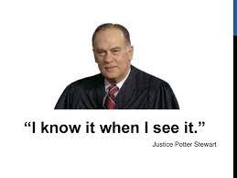
On the non-definition of psychiatric futility
I may not be able to define pornography
but
Notes:
Of course depends on whether you’re the principal or sitting on the board for a 6th grade art class in Florida
Speaks to the variability that will exist in practice with the existing laws
Doesn’t matter because in the current law, you can refuse treatment

Slide 9
A MAiD request should open a Conversation not a Conduit
No explicit role in the law for clinician judgment to protect vulnerable persons ”from being induced, in moments of weakness, to end their lives”
desire to die statements are first an opportunity for discussion about symptoms and goals of care
clinicians should be trained to have a therapeutic conversation with patients to help them understand their own request for MAiD so that they can make the best decisions for themselves
Notes:
Not take the reasons a patient says they want MAID at face value. Required to ask why they want MAID, not required to have a therapeutic conversation
I try to talk patients out of having MAID, if they still want it, then I give it to them

Slide 10
Canadian MAiD Curriculum
First nationally accredited bilingual MAiD training in Canada
27 RCPSC self-assessment hours
Online and in-person formats
Free until March 2026
7 Topics with embedded Reflection and Resilience
Foundations
Clinical Conversations
MAiD Assessment
Assessing Capacity and Vulnerability
Providing MAiD
Navigating Complex Cases
MAiD & Mental Disorders
https://camapcanada.ca/curriculum/

